Slide 1
Practice 3 - CPUScheduler Simulator V2

Slide 2
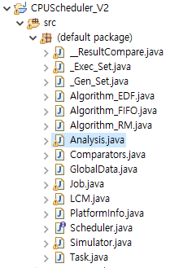
CPUScheduler Simulator V2 - Source Code Description
Current code status (V2)
Uniprocessor is available
actually multiprocessors can be exploited by modifying corresponding variable in GlobalData.java
RM, EDF, FIFO are implemented
in Algorithm_RM.java
in Algorithm_EDF.java
in Algorithm_FIFO.java
(At least 1000, up to 100,000) Task sets are randomly generated with bimodal and exponential distributions
The number of task sets that can be generated is dependent on the number of considered distribution and seed numbers
The skeleton code for Utilization based analysis for RM and EDF are implemented
In Analysis.java
Graph generation code is not included yet
I/O will not be considered

Slide 3
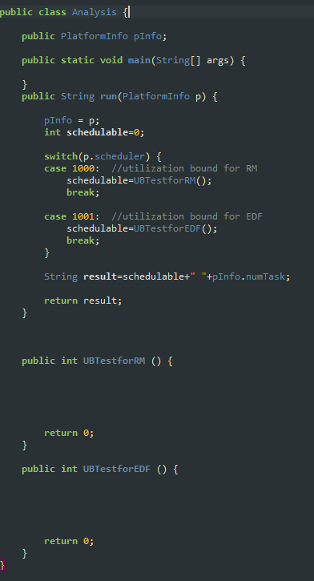
Utilization based analysis
You should complete implementing Utilization based analysis for RM and EDF in CPUScheduler V2
Modify here !
(Analysis.java)

Slide 4
RM – Utilization Bound
Real-time system is schedulable under RM if
∑U_{i} ≤ n (2^{1/n}-1)
Liu & Layland,
“Scheduling algorithms for multi-programming in a hard-real-time environment”, Journal of ACM, 1973.
n = the number of tasks in a task set

Slide 5
EDF – Utilization Bound
Real-time system is schedulable under EDF if and only if
∑U_{i} ≤ 1
Liu & Layland,
“Scheduling algorithms for multi-programming in a hard-real-time environment”, Journal of ACM, 1973.
Exact analysis

Slide 6
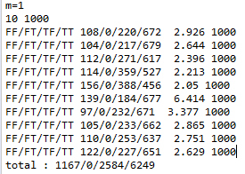
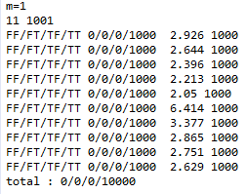
Utilization based analysis
You will see the following results by executing __ResultCompare.java
Comparing 10 with 1000
Comparing 11 with 1001

Slide 7
Practice 3 HW
Submission files
Analysis.java (yours)
Captured output (in console window) figures; one that you saw in the previous slide
Two captured output for RM and EDF, respectively.
Firm deadline : 2019 4. 29. (4. 30. for evening class) AM 10:00
About three weeks are provided
Instead, no delay is allowed
Delayed submission is graded as 0
Wrong output(source code as well) is graded as 0
Duplicated (from other peers) source code is graded as 'F‘
You should explain how to implement your source code in our class

